Slide 1
ANL252 – Assessments, weightage, deadlines
Time frame and Deliverables
Assessment | Weightage | Deadline
Pre-Course Quiz 1 | 2% | 27 January 2023, noon
Pre-Class Quiz 1 | 2% | 6 February 2023, noon
Tutor Marked Assignment | 18% | 5 February 2023, 2355hrs
Group Based Assessment | 20% | 19 February 2023, 2355hrs
Pre-Class Quiz 2 | 2% | 20 February 2023, noon
End-of-Course Assessment | 50% | 6 March 2023, 1200 noon
Participation | 6% (30% from class, 70% from forum)

Slide 2
Learning Objectives of ANL252
By the end of this Session
Create, use, and perform operations on 3 compound built-in data types: tuples, lists and dictionaries
Use the Python built-in functions and their associated methods
Create user-defined functions for application to programming tasks
Explain the concepts of packages and modules, and how Python manages and imports packages and modules
Solve problems using appropriate Python standard libraries

Slide 3
Study Unit 2 Data Types and Functions

Slide 4
Tuples

Slide 5
Define Tuples
A collection of values written as comma-separated items between a pair of round brackets.
Tuples are not specifically designed for mathematical operations.
A tuple is like a database record
Example: Employee_A1 = (“Jimmy Chow”, “Engineer”, “Grade 2”)
The items in a tuple can be numeric, string, or a mixture of both.
Useful when sharing data with others but not giving others the permission to edit the contents (aka, Immutable --- the contents cannot be changed)
tuple_name = (element1, element2, …)
Notes:
We know that we could store values in a variable for later operations in our code.
The type of a variable depends on whether we want to store numeric values or character strings in it.
More often we work with multiple data points of the same nature such as the names of all students in a class.
It would be inconvenient to create a new python variable for each data point like e.g., student1, student2, etc. What we can do instead is to store all data points in some kind of compound data structure.
Python facilitates several types of compound data for our use. One of these data types is the tuple.
A tuple is a collection of values written as comma-separated items between a pair of round brackets, similar like vectors in mathematics.
Unlike vectors, tuples are not specifically designed for mathematical operations. The items, or elements in a tuple can be numeric, string, or a mixture of both.
Note that tuples are immutable, that is, we are not allowed to modify them once they are defined.
Nevertheless, they are more efficient in terms of performance and memory use.
Tuples are useful in situations where we want to share the data with other users but not allow them to edit the content.

Slide 6
Subset and Index Tuples
Use index operator [] to access specific elements in a tuple.
The index begins with 0 and ends with the number of elements minus 1.
To subset multiple elements, put the start and end indices, connected by a colon in the index operator.
Important: The end index is NOT included in the subsetting procedure.
Apply negative indices to access elements starting from the last element.
tuple_subset = tuple_name[start:end]
Notes:
To access one specific element in a tuple, we can use the index operator [].
In Python, the index of any compound data type, i.e., tuples, lists and dictionaries, begins with 0 and ends with the total number of elements minus 1.
In other words, the index for the first element in a tuple is 0, the index for the second element is 1, and the third one is 2, and so on.
If we want to subset more than a single element of a tuple, we can put the start and end indices in the index operator, connecting them with a colon.
It is important to recall that the end index will not be included in the subsetting procedure.
We can also use negative indices to access the elements of a tuple starting from the last element.
That is, the index -1 indicates the last element, -2 the second last, etc.

Slide 7
Example of index
Suppose we have a tuple of fruits, named as Fruits
We can index this tuple using a positive index
Alternatively, we can refer to elements of this tuple using a negative index
Fruits = (“Apple”, “Orange”, “Banana”)
Fruits = (“Apple”, “Orange”, “Banana”)
Index 0
Index 1
Index 2
Fruits = (“Apple”, “Orange”, “Banana”)
Index -3
Index -2
Index -1

Slide 8
Example of subset
Returning to our tuple named as ‘Fruits’
Creating Fruits_Subset = Fruits[0:2], obtain all elements except index 2
Create Fruits_Subset = Fruits[-3:-1], obtain all elements except index -1
Fruits = (“Apple”, “Orange”, “Banana”)
Fruits_Subset = (“Apple”, “Orange”)
Index 0
Index 1
Fruits_Subset = (“Apple”, “Orange”)
Fruits = (“Apple”, “Orange”, “Banana”)
Index -3
Index -2
Index -1

Slide 9
Edit and Concatenate Tuples
Recall: Tuples are immutable.
Values of a tuple cannot be changed.
We are also not allowed to add a new value to an existing tuple.
Notes:
Though we can access the tuple elements by using the index operator, we are neither allowed to change the values of it nor to add a new value to an existing tuple.

Slide 10
Length of Tuples
The length of a tuple is the number of elements in it.
Use as an index to subset a tuple
Control the indexing so that the indices do not get out of range.
tuple_length = len(tuple_name)
Notes:
When dealing with tuples, lists or dictionaries, the function len() can be useful since it will return the length, i.e., the number of elements in the object.
The length is often also used as an index to subset a tuple or control the indexing in our code so that we cannot refer to indices that go beyond the largest index of a tuple.

Slide 11
For-Loops and Tuples
Tuple elements are can accessible by running a for-loop iteratively.
Put the name of the tuple in the for-statement directly.
It is also applicable to lists and dictionaries.
for counter in tuple_name:
instructions
Notes:
One advantage of tuples, or other compound data types, is that we can access and extract their elements by using the for-loop iteratively.
We can use the range() function to generate a list for the for-loop to run over it.
Generally, if there are tuples, lists or dictionaries already created and existing while the program is running, we can use the for-loop directly by putting the name of the tuple, list, or dictionary in the for-statement.
In the syntax here, tuple_name can certainly be replaced by list_name or dictionary_name.

Slide 12
Activity
Car sales program:
Construct a tuple of the car brands you know (e.g., Toyota, Kia, BMW, Chrysler, Mercedes Benz, Porsche, Fiat, etc.). Extend the Car sales program from Study Unit 1 by listing the car brands stored in the tuples and listed them out on the screen when the user is asked to enter the brand of the car.
Note that the user must enter one of the brands in the tuple, i.e., any brand not stored in the tuple is considered as invalid input. Furthermore, the exact spelling of the brand in the tuple should also be stored in the variable for the car brand input.

Slide 13
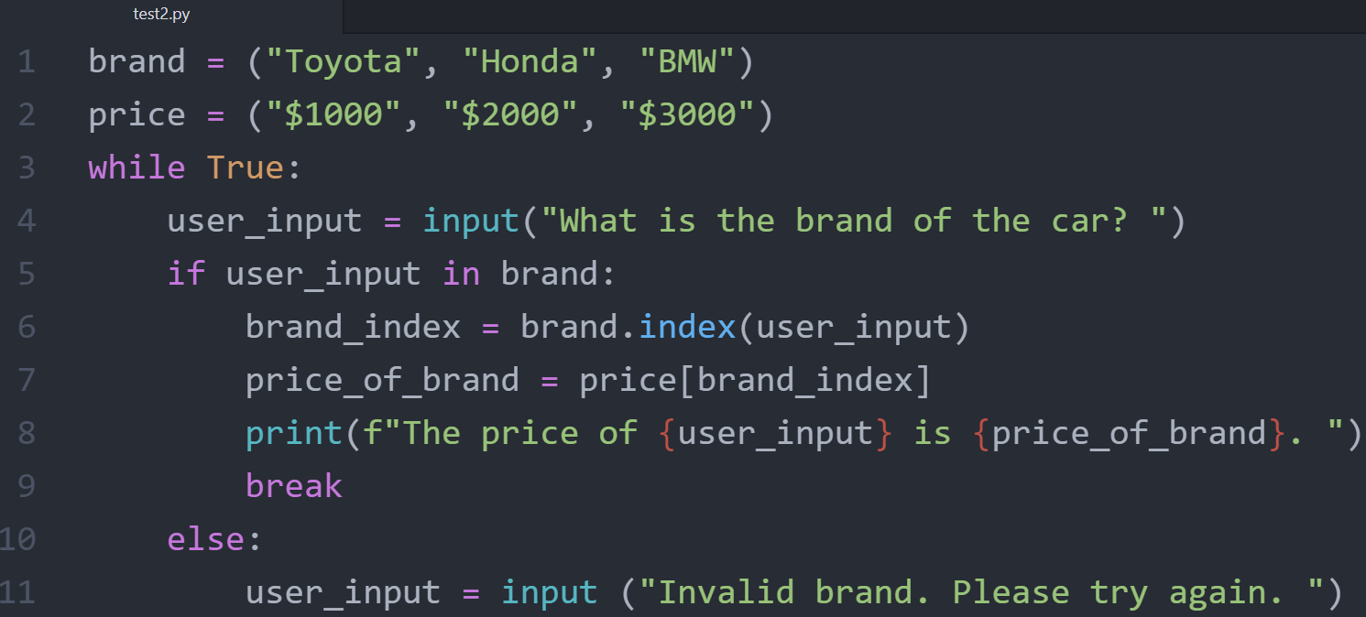
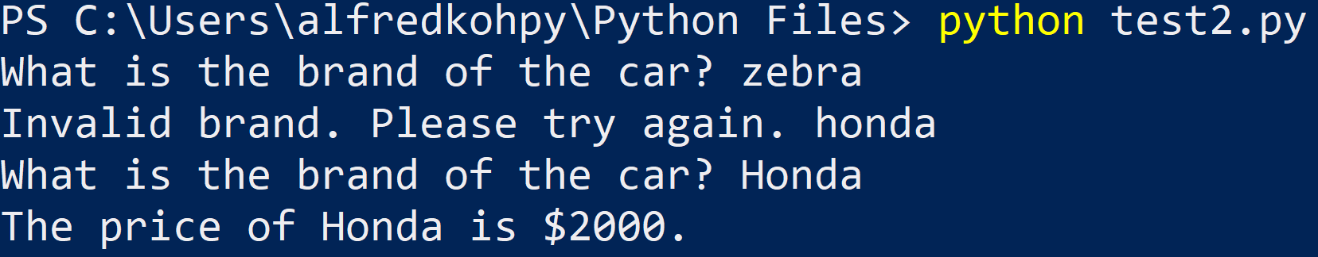
Activity (Answers)

Slide 14
Discussion
What is the advantage and disadvantage of using an immutable compound data structure such as a tuple?
When is it sensible to use negative indexing instead of the conventional method?

Slide 15
Discussion (answers)
What is the advantage and disadvantage of using an immutable compound data structure such as a tuple?
Avoid overwriting tuple by mistake
When is it sensible to use negative indexing instead of the conventional method?
When there are many elements, and our desired element is at the end of the tuple

Slide 16
Lists

Slide 17
Create Lists
A Python list is just like a tuple with two main differences:
Data are comma-separated and wrapped by a pair of square brackets.
Content is modifiable.
We can construct a Python list in a similar fashion like a tuple.
The square brackets are not omittable.
Contents can be any type of objects: floats, integer, Booleans, strings, tuples, or even lists.
list_name = [element1, element2, …]
Notes:
Another type of compound data in Python is the list. A list is just like a tuple with two main differences:
The data are comma-separated items wrapped by a pair of square brackets.
The content of a list is modifiable.
We can construct a Python list in a similar fashion like a tuple.
As mentioned before, we must wrap the data in a list by square brackets.
However, unlike a tuple which we may omit the round brackets when defining it in our code as long as the data are separated by commas, we must define a list with the square brackets in our program.
If we omit the brackets, Python will interpret the data as a tuple.
Same as tuples, lists can contain any type of values: floats, integers, Booleans, strings, or more advanced Python types like lists.
The last one is indeed a very interesting property of Python compound data since we can namely put a list within a list, or a tuple in a dictionary, and so on.

Slide 18
Subset Lists
Use index operator [] to access specific elements in a list.
All indexing and subsetting techniques for tuples are applicable to lists.
list_subset = list_name[start:end]
Notes:
We can also access elements of a list by the index operator.
All the indexing and subsetting techniques for tuples are applicable to lists.

Slide 19
Modify Lists
Modify specific list items by subsetting and assigning new values to them.
Use multiple indexing to edit multiple items.
The list of new values will occupy the locations within [start index:end index] loactions on the left-hand side. The list on the left-hand side will expand or shrink accordingly.
list_name[index] = new value
list_name[start index:end index] = [list with new values]
Notes:
Different from tuples, we can change the content of a list or add elements to it.
To edit specific items of a list, we simply assign new values to them after subsetting them.
We can also use multiple indexing to edit multiple items.
If we only intent to edit the items in the list, then the length of the indices on the left-hand side, which is the number of items to be modified, must be the same as the length of the list with the new values.
If the list of new values is longer than the indices, items will be added to the list on the left-hand side.
On the other hand, if the list of indices is shorter, items will be removed from the original list.

Slide 20
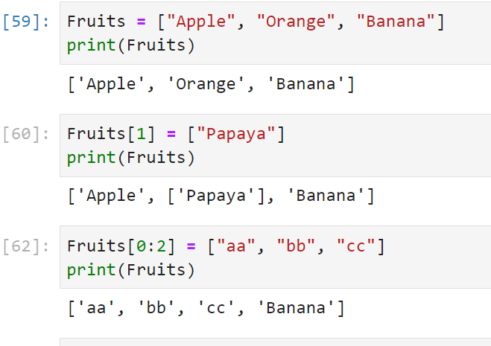
Examples of modifying lists
Index 0
Index 1
Index 2
Replacement
Replace & expand

Slide 21
Examples of modifying lists
We first create a list known as ‘Fruits’
If we enter Fruits[1] = “Papaya”, we get
Instead, If we enter Fruits[0:2] = [“Papaya”], we get multiple edits
Fruits = [“Apple”, “Orange”, “Banana”]
Index 0
Index 1
Index 2
Fruits = [“Apple”, “Papaya”, “Banana”]
Fruits = [“Papaya”, “Banana”]

Slide 22
Some subtle points
Fruits[0:1] is a list [“Apple]
To replace a list, we need a list
Fruits[0:1] = [“Papaya”]
Fruits[0] is a string, i.e., “Apple”
To replace a string, we need a string
Fruits[0] = “Papaya”

Slide 23
Concatenate Lists
We can concatenate multiple lists into one by “adding” them together.
Addition operation “+” is used to concatenate objects such as string, tuples, or lists.
Concatenating lists is recommended if content and type of the lists are identical.
Even if the nature of the two lists is not identical, it is sometimes quite convenient to store the data in one list for later use.
combined_list = list1 + list2 + …
Notes:
Same as tuples, we can concatenate multiple lists into one by “adding” them together.
Basically, Python use the addition operation “+” to concatenate objects such as strings, tuples, or lists, rather than to carry out arithmetic addition except for numeric values.
Even if the nature of the two lists is not identical, it is sometimes quite convenient to store the data in one list for later use.

Slide 24
Example of concatenating lists
Suppose we have two lists, Fruits and Vegetables
Generate Combined = Fruits + Vegetables
Fruits = [“Apple”, “Orange”, “Banana”]
Vegetables = [“Spinach”, “Lettuce”, Cabbage”]
Combined = [“Apple”, “Orange”, “Banana”,
“Spinach”, “Lettuce”, “Cabbage”]

Slide 25
Merge Lists
Meaning and source of the elements in a concatenated list with different nature of data will become untraceable with time.
Merge two lists into a new list without combining the elements together.
Each element of the new list is a list and not a single value.
Define a new list by putting the list names as elements.
Use index to refer to a whole sub-list.
Possible to trace back the origin and meaning of the data in the new list.
List_name = [list1, list2, …]
Notes:
Usually, after combining two lists, we will have difficulty to distinguish the original nature of the elements, such as meanings and types.
For instance, in the example before, suppose the first item in the list scores is the exam score of the first student in names, that is, Peter’s exam score is 72, we will not be able to assign the score to the corresponding name unless we know that each score always belongs the name five positions before.
If we keep in mind that the length and contents of the concatenated list may change every now and then, the meaning and source of each element will become more and more untraceable with time.
Another way to solve this problem is to merge two lists into a new list without combining the elements together. Instead, each element of the new list is a list and not a single value.
To merge two lists into a new list while keeping them as “list elements”, we cannot use the addition operator as introduced before. Instead, we define the new list by putting the list names instead of some values as the elements.
The advantage of this merging technique is that we will always know that index 0 of the new list refers to the list names and index 1 to the list scores if the new list is a combination of two known lists in a fixed sequence.
As a result, we will be able to trace back the origin and meaning of the data in the new list.
Note that this merging technique is not limited to merging lists. We can also merge two tuples into a list and keep their types as tuple in the new list as well.
To access a single element of the merged list, we need to use the double index operator [] since single index operator would return one of the original lists to us.

Slide 26
Example of merging lists
Suppose we have two lists, Fruits and Vegetables
Now merge the two lists: Combined = [Fruits, Vegetables]
Fruits = [“Apple”, “Orange”, “Banana”]
Vegetables = [“Spinach”, “Lettuce”, Cabbage”]
1st element of Combined is Fruits
Combined = [ [“Apple”, “Orange”, “Banana”],
[“Spinach”, “Lettuce”, “Cabbage”] ]
2nd element of Combined is Vegetables

Slide 27
Print Lists
Use loops to subset lists and print the items to the screen.
Include lists in the for-statement to print the list items instead of using range().
for counter in list_name:
instructions
Notes:
Loops are very useful when working with lists. The reason is obvious: since the items of a list can be accessed by their indices, we can easily use loops to subset, print, or modify them.
Nevertheless, according to the general understanding, we need to first generate a list of integers to serve as sort of a counter for the iterations of for-loops.
Now, after being familiarised with the concept of lists, we do not always need the range() function to create these integers for us. Instead, we can simply use any available list as our counter.
Nevertheless, the range() function can still be very useful in some situations.

Slide 28
Enter Data to Lists
User-defined instead of pre-defined values for list items.
Let users enter their own data by the input() function.
Store the input into a list.
Do not limit the number of entries and use a while-loop with appropriate exit condition.
Notes:
So far, we assign pre-defined values to the lists in our code directly.
But we can also let the user enter his own data and store them into a list by the input() function.
If we do not limit the number of entries, a while-loop with an appropriate exit condition will be the right approach here.

Slide 29
Activity for Study Unit 2
Boston housing data:
Use Jupyter lab.
Go to the ANL252_HousingData_Demo notebook file and run through the cells that converts array to tuples and lists for the housing dataset
There are also graphical plots you can apply to help you explore the data
Discuss your observations from the program outputs

Slide 30
Activity --- Discussion
Car sales program:
Extend the Car sales program by storing all the car brand, model and price of each entry in a list within the “outer” list in which all the entries of the user inputs are stored.

Slide 31
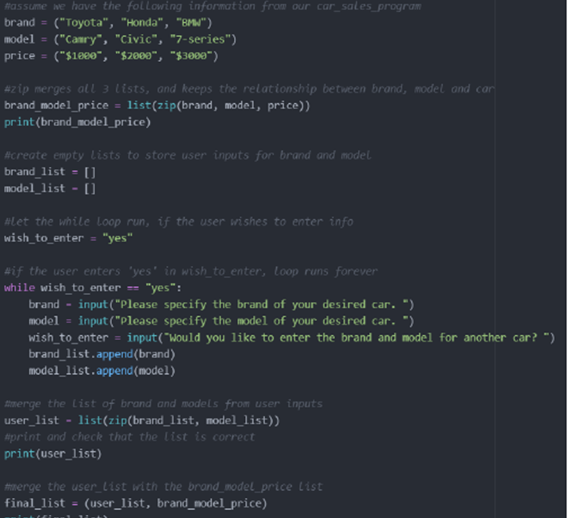
Activity (Answers)
Car sales program:
Extend the Car sales program by storing all the car brand, model and price of each entry in a list within the “outer” list in which all the entries of the user inputs are stored.
Notes:
We need two lists, one for car attributes, and one for user inputs

Slide 32
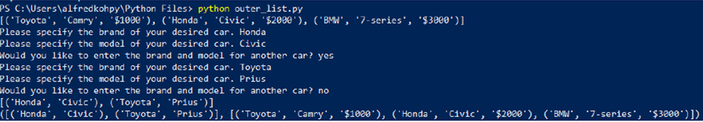
Activity (Answers)
Car sales program:
Extend the Car sales program by storing all the car brand, model and price of each entry in a list within the “outer” list in which all the entries of the user inputs are stored.
Notes:
We need two lists, one for car attributes, and one for user inputs

Slide 33
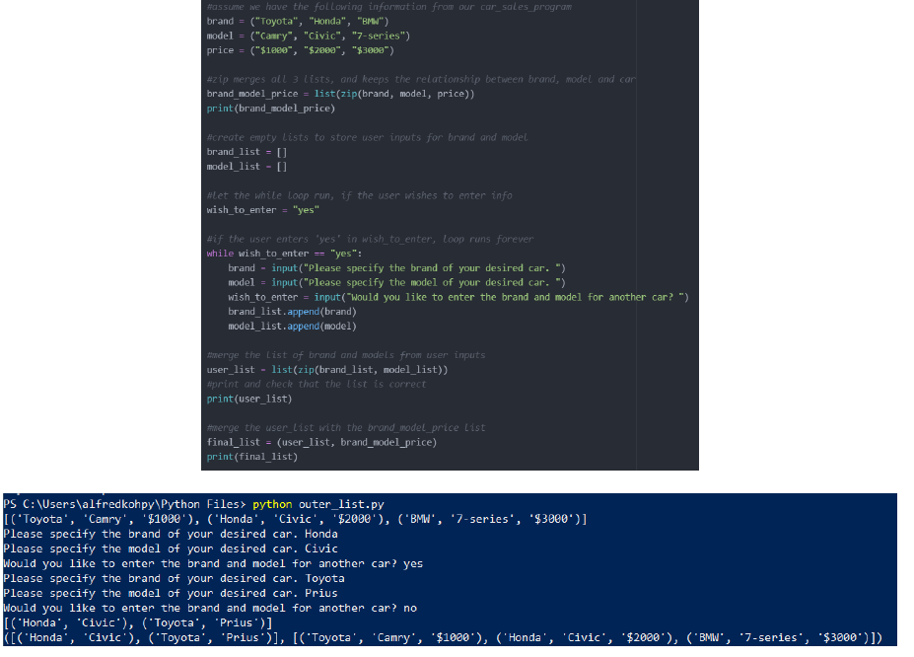
Activity (Answers)
Car sales program:
Extend the Car sales program by storing all the car brand, model and price of each entry in a list within the “outer” list in which all the entries of the user inputs are stored.
Notes:
We need two lists, one for car attributes, and one for user inputs

Slide 34
Discussion
How different is the syntax format between tuples and lists?
When is it sensible to include compound data structures like lists or tuples as elements in a list?

Slide 35
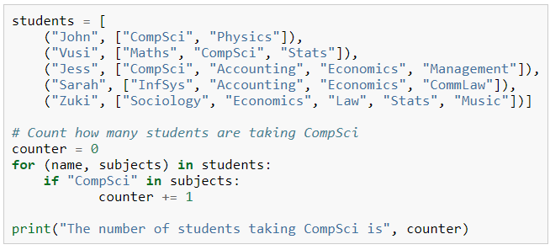
Discussion (Answer)
How different is the syntax format between tuples and lists?
() for tuple, [] for lists
When is it sensible to include compound data structures like lists or tuples as elements in a list?
e.g., when students take different numbers of classes in a term

Slide 36
15 min break

Slide 37
Dictionaries

Slide 38
Define and Access Dictionaries
A dictionary is an unordered set of key:value pairs.
The keys must be unique within one dictionary.
The key:value pairs are separated by commas and wrapped in a pair of braces.
Dictionaries are indexed by keys, which are usually strings or numbers.
Extract values in a dictionary by the keys.
dictionary_name = {"key1":value1, "key2":value2, …}
value = dictionary_name["key"]
Notes:
Another useful built-in data type is the dictionary. It is best to think of a dictionary as an unordered set of key:value pairs, with the requirement that the keys are unique (within one dictionary).
The key:value pairs are separated by commas and wrapped in a pair of braces.
Unlike lists and tuples, which are indexed by a range of numbers, dictionaries are indexed by keys, which are usually strings or numbers. As a result, we use the keys to subset a dictionary instead of indices.

Slide 39
Examples of Dictionaries
Let us create a dictionary for the prices of our Fruits list
To get the price of Apple, we
Fruits_Price = {"Apple": 1.20, "Orange":0.70, "Banana":0.90}
Apple_Price = Fruits_Price["Apple"]
Notes:
Another useful built-in data type is the dictionary. It is best to think of a dictionary as an unordered set of key:value pairs, with the requirement that the keys are unique (within one dictionary).
The key:value pairs are separated by commas and wrapped in a pair of braces.
Unlike lists and tuples, which are indexed by a range of numbers, dictionaries are indexed by keys, which are usually strings or numbers. As a result, we use the keys to subset a dictionary instead of indices.

Slide 40
Print Dictionaries
Printing syntax for dictionaries is quite different from tuples and lists.
It is possible to use the key to extract a value, but index operator [] cannot refer to the keys.
Use .keys() and .values() to extract the dictionary’s keys and values.
Apply .item() to extract all keys and values in the same step.
dictionary_name.keys()
dictionary_name.values()
dictionary_name.items()
Notes:
We can use for-loops to print out items from a dictionary line by line. However, the syntax is quite different from tuples and lists since each entry in a dictionary contains two elements: key and value. On the one hand, we can use the key to extract the corresponding value. On the other hand, we cannot simply use the index operator [] to refer to the keys. One possibility to get the keys of a dictionary is to use the .keys() method:
Equivalently, the .values() method can extract all values from a dictionary.
Method is like a function to carry out certain actions on the object before the dot (.). Here, the object is a dictionary, and the methods are .keys() and .values(). Applying this syntax on any dictionary, Python can extract all the keys or values from it.
If we want to extract all keys and values from a dictionary in the same step, we can apply the .item() method on a dictionary.
Same as the .keys() and .values() methods, the result returned by Python from the .items() method is not an object that can be accessed directly. Nevertheless, it can be converted to a list of keys and values by the list() function.

Slide 41
Examples of printing dictionaries
Using Fruits_Price.keys(), we get the dictionary’s keys
Using Fruits_Price.values(), we get the dictionary’s values
Using Fruits_Price.items(), we get the dictionary’s keys and values
dict_keys = ["Apple", "Orange", “Banana"]
dict_values = ["1.20", "0.70", "0.90"]
dict_items = ([("Apple",1.20), ("Orange", 0.70), ("Banana", 0.90)])

Slide 42
Print Dictionaries Items
A dict_items() object contains tuples with keys and values as items.
Use a for-loop and the index operator to print the contents.
Extend the for-loop so that indices are omitted when referring to dictionary items.
The for-loop can also iterate through any list created from a dictionary.
Two temporary storage variables instead of one are in the for-loop: one for the key, one for the value.
for element1, element2 in list(dictionary_name.items()):
instructions
Notes:
The list created from a dict_items() object contains tuples that have two elements in each of them: the keys and the values. We can easily use a for-loop and the index operator to print the contents. Here, we introduce an extension of the for-loop so that we can omit the indices when referring to the keys and values.
The syntax list(dictionary_name.items()) in the for-loop can certainly be replaced by any defined list created from a dictionary.
The main difference between the usual for-loop we know and the one we introduce here is that we use two temporary storage variables instead of one in it.
The mechanism is rather simple. In each iteration, Python will extract one tuple from the list, and each element of the tuple will then be stored in one of these storage variables. Since the keys are stored first in the tuples, element1 will contain the key, and element2 will contain the value. If we want to use these two values in our instructions, we can simply refer to these variables without using the index operator.

Slide 43
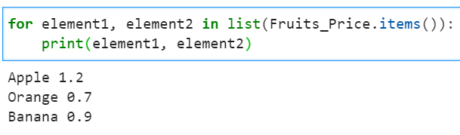
Example of printing dictionary items
Printing the items of our Fruits_Price dictionary

Slide 44
Edit Dictionaries
Change a value of a dictionary by assigning a new value to a certain key.
The value can be a numeric value, a character string, a tuple, or a list.
dictionary_name["key"] = value
Notes:
We can change a value of a dictionary by assigning a new value to a certain key.
The value can be a numeric value, a character string, a tuple, or a list.

Slide 45
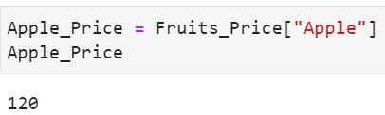
Example of editing dictionary
Let us change the price of Apple from 1.20 to 120.
Verify that the price of Apple is 120 in Fruits_Price.
Fruits_Price["Apple"] = 120

Slide 46
Change Dictionary Keys
Editing a key in a dictionary is not straightforward.
The keys are immutable and cannot be changed directly.
Instead, we can create a new key in a dictionary, take over the values from the old key, and then delete the old key.
The syntax del deletes an object in Python, including a dictionary key.
Once an object is deleted, it will no longer be available in the program.
del object
Notes:
While assigning new values to a key in a dictionary is rather straightforward, editing a key in a dictionary is not a simple task in Python.
Basically, the keys of a dictionary are immutable and cannot be changed directly.
But we can create a new key in a dictionary, take over the values from the old key, and then delete the old key in the last step. To delete a key in a dictionary, we can use the syntax del.
Note that the object in the del syntax does not only refer to a key in a dictionary. It can be any Python object such as a variable, a list, a tuple, a dictionary etc. Once an object is deleted, it will no longer be available in the program.

Slide 47
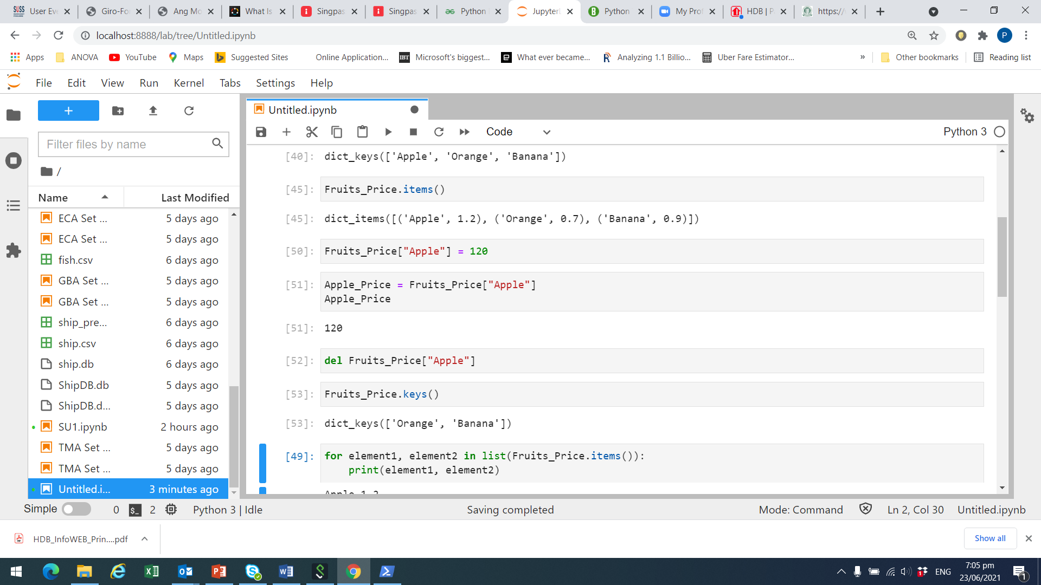
Example of deleting
Delete the key, Apple, in Fruits_Price
Verify the key, Apple, is deleted from Fruits_Price

Slide 48
Add Items to Dictionary
To add a dictionary key, we simply assign a value to a new key.
The syntax is just the same as the syntax to edit an existing key.
The only difference is that the key in the index operator must be a new one here, and an existing one for editing.
dictionary_name["new key"] = value
Notes:
On the other hand, if we want to add a new key to a dictionary, we can simply assign a value to a new dictionary key.
Basically, the syntax to add a new key is just the same as the syntax to edit an existing key. The only difference is that the key put in the index operator must be a new one if we wish to add a new item.

Slide 49
Merge Dictionaries
To merge two dictionaries, Python offers two options.
Syntax for Python version 3.9 onwards uses the “Bitwise Or” operator “|” to merge two dictionaries:
Syntax for Python version 3.5 onwards:
new_dictionary = dictionary1 | dictionary2
new_dictionary = {**dictionary1, **dictionary2}
Notes:
However, if we want to merge two dictionaries, Python offers two options.
The first syntax is a new option available from Python version 3.9 onwards. It uses the “Bitwise Or” operator, which is a vertical line “|”, to merge two dictionaries. The second syntax is an option available from Python version 3.5 onwards.

Slide 50
Activity
Car sales program:
Modify the Car sales program in a way that the car brands are stored as the keys of a dictionary. The value of the corresponding dictionary key is a sub-dictionary in which the model is used as key and the price is stored as value.
Note that we should only have one key for each brand in the dictionary. That means, if the user enters multiple cars for the same brand, the value of that key should be a sub-dictionary which contains multiple keys. And the value for each of the key in the sub-dictionary is the price of one model.

Slide 51
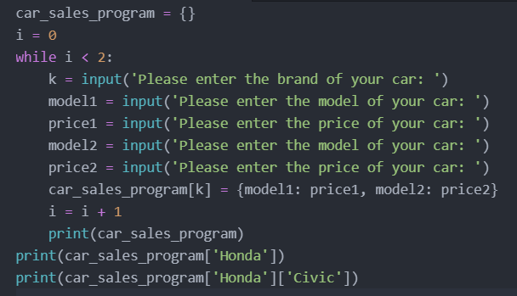
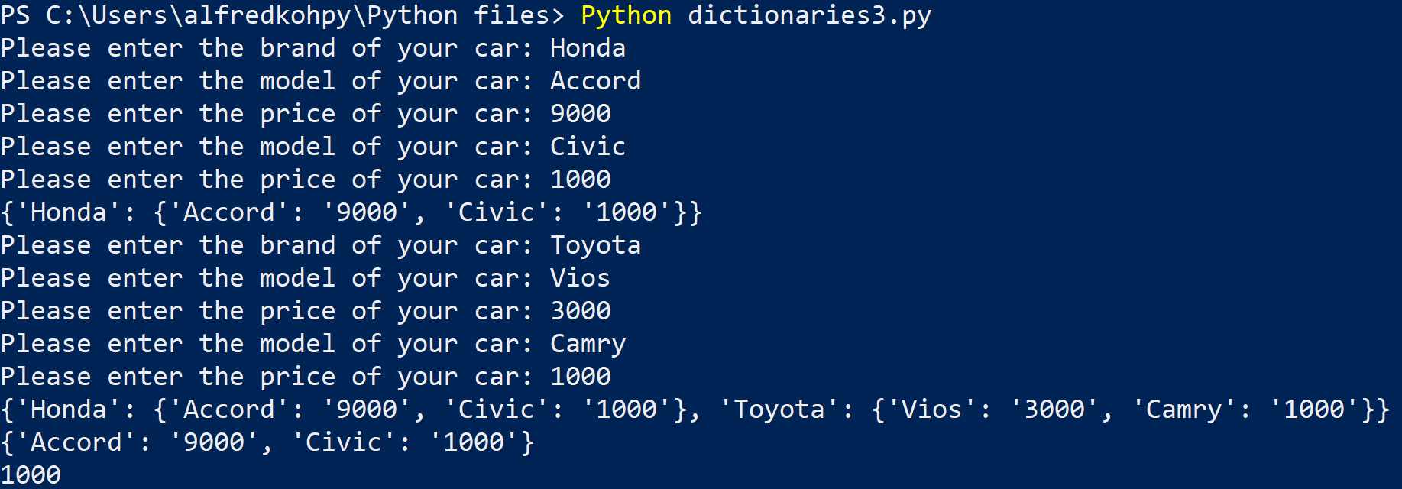
Activity (answer)
Notes:
We need a dictionary of dictionaries. Refer to dictionaries3.py

Slide 52
Discussion
When is it sensible to use dictionaries instead of tuples and lists?
How do we edit the values and keys of a dictionary? What are the required steps here?

Slide 53
Discussion (answers)
When is it sensible to use dictionaries instead of tuples and lists?
When we have key-value pairs
How do we edit the values and keys of a dictionary? What are the required steps here?
Edit value: assign new value to a specific key
Edit key: delete key and create new key-value pair

Slide 54
15 min break

Slide 55
Integrated Methods and Functions

Slide 56
Functions
Functions are routine programs for value processing.
Values are passed on to functions as arguments/parameters and results will be returned as output to the user.
E.g., int() removes all decimal digits of a value and returns an integer as result.
Notes:
A function is a routine program that processes values which are passed on to it as an argument and returns some results to the user eventually.
For example, a float value is passed on to the int() function as an argument, and Python will remove all the decimal digits and return an integer as result.

Slide 57
Built-In Functions
Built-in functions are integrated in Python, e.g., print(), input().
Here is a list of all Python built-in functions in alphabetical order.
(Source: https://docs.python.org/3/library/functions.html)
abs() | all() | any() | ascii() | bin()
bool() | breakpoint() | bytearray() | bytes() | callable()
chr() | classmethod() | compile() | complex() | delattr()
dict() | dir() | divmod() | enumerate() | eval()
exec() | filter() | float() | format() | frozenset()
getattr() | globals() | hasattr() | hash() | help()
hex() | id() | input() | int() | isinstance()
issubclass() | iter() | len() | list() | locals()
map() | max() | memoryview() | min() | next()
object() | oct() | open() | ord() | pow()
print() | property() | range() | repr() | reversed()
round() | set() | setattr() | slice() | sorted()
staticmethod() | str() | sum() | super() | tuple()
type() | vars() | zip() | __import__()
Notes:
We have come across various built-in functions of Python, such as print(), input(), int(), etc. These functions are always available in the Python environment.
Some of the listed functions here are rather straightforward such as abs(), sum(), round() etc. There are also some that are quite unclear in terms of their functionality or area of use such as frozenset() or staticmethod() just by looking at their names.
You can visit the website https://docs.python.org/3/library/functions.html to get detail explanation on how to integrate and apply all these functions in Python programs.
You may wonder why some rather basic functions such as a function for the calculation of the mean is missing in the list. Some of those functions may be included in some common packages. Some of them could be built-in methods instead.

Slide 58
Built-In Methods in Python
Methods are routines that are applied to the objects they are attached to.
E.g., .format() for formatting string, .keys(), .values() and .items() for dictionaries.
Methods return results to the program once they are applied on defined objects during runtime.
Each method is only applicable to certain object types.
The list of some common methods can be found on:
https://www.w3schools.com/python/python_ref_tuple.asp https://www.w3schools.com/python/python_ref_list.asp https://www.w3schools.com/python/python_ref_dictionary.asp https://www.w3schools.com/python/python_ref_string.asp
Notes:
Some routines in Python are not supposed to be applied as functions in the Python environment, instead they are methods that can be applied to the object they are attached to.
We know that the method .format() can be used for formatted printing; and the .keys(), .values() and .items() methods can be applied on dictionaries to extract their keys and values.
Same as functions, there are built-in methods that are always available in the Python environment.
These methods will return results to the program once they are applied on defined objects during runtime.
However, each method can only be applied to a certain object type. Here are the addresses of four websites where we can find the list of some common methods.

Slide 59
Activity for Study Unit 2
Boston housing data:
Use Jupyter lab.
Go to the ANL252_HousingData notebook file and run through the cells that apply built-in functions to summarise values found in array, tuples and lists for the housing dataset
Discuss your observations from the program outputs
Try some graphical plots on your own to explore the data.

Slide 60
Activity
Car sales program:
Modify the Car sales program in a way that the trailing and leading white spaces in the inputs of the car brand and model should be removed by some built-in Python functions.
Furthermore, the first letter of the brand should be stored in capital letters (only the first letter of the entire input, not the first letter of each word in the input) while all the subsequent letters should be kept in the format as entered by the user.

Slide 61
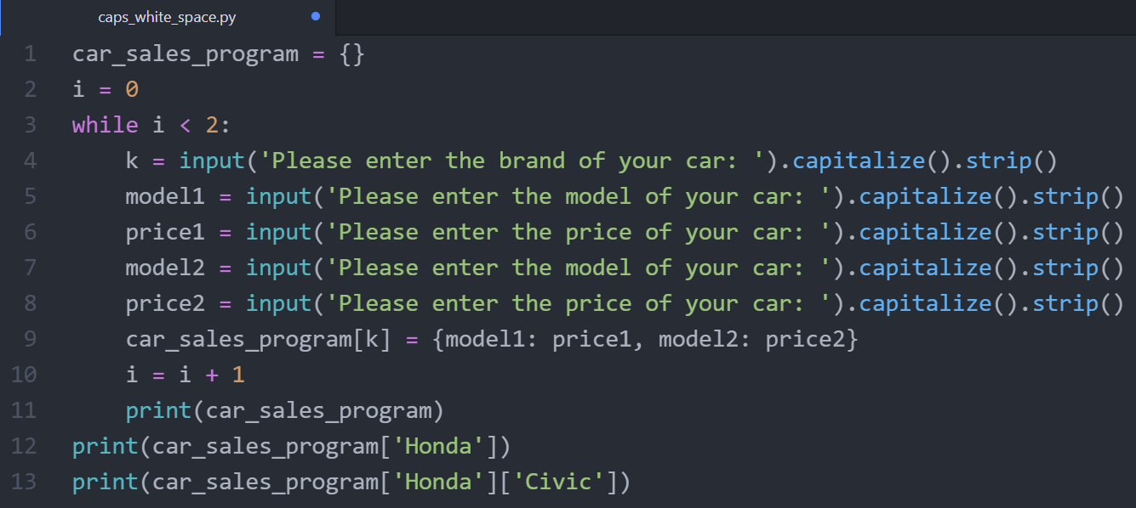
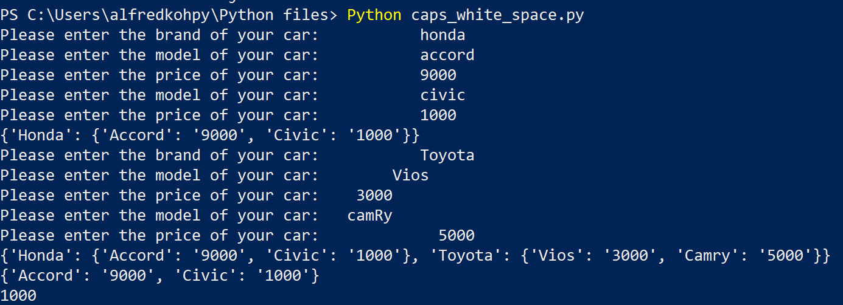
Activity (answer)
Notes:
Use Title to capitalize and

Slide 62
Discussion
What are the components of a built-in function or method, and where can we get those information before applying them in our program?
Can we avoid the use of functions or methods and write such routines by ourselves?

Slide 63
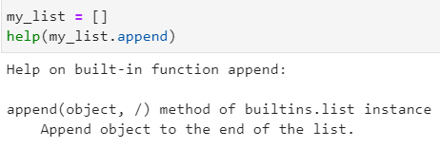
Discussion (answer)
What are the components of a built-in function or method, and where can we get those information before applying them in our program?
Use the help() command
Can we avoid the use of functions or methods and write such routines by ourselves?
user-written functions

Slide 64
User-Defined Functions
User-defined functions are functions that we write to suit our own needs.
They will only be executed when they are called from the main program.
A function consists of four parts:
Function name
Arguments
Instructions
Output object (or value)
Notes:
We have been introduced to some built-in functions and methods that are already included in the Python programming environment. Functions and methods help us to carry out routine tasks which would require us to write very lengthy code to achieve the same functionality if we were to create the program by ourselves. Nevertheless, sometimes we like to write our own functions that suit our own needs.
A user-defined function (we will call it function in the following for simplicity purpose) can be viewed as a separate part of the code that will not be interpreted by Python until it is called from the main program. Usually, a function consists of four parts:
the function name
some arguments, i.e., values or parameters the function needs for its processing. This part is optional. If the function has no arguments, it will simply process all the instructions without any input from the main program.
the instructions of how and what to process within the function
an object (or a value) that should be returned to the main program at the end of the function. This is also optional. If no return object is specified, the main program will proceed without any output from the function.

Slide 65
Correct Use of User-Defined Functions
No “outsourcing” of main program parts to functions because of “program cleanliness”.
Debugging is challenging if the code jumps between main program and functions.
Rules of thumb for using user-defined functions:
Same routine appears more than once in main program.
Combination of various functions is used on multiple occasions.
Increase of main program’s efficiency.
Notes:
Caution! It is tempting for beginners to “outsource” some parts of the main program and make them separate functions for the sake of “program cleanliness”. Though the code may look more structured at the first sight, the debugging process can be quite challenging if the whole program is jumping between the main program and the functions. The rules of thumb for using user-defined functions appropriately are:
if the same routine, probably with different arguments, appears more than once in the main program
if several functions should be combined into one which then will be used in the main program on multiple occasions
if a function can really increase the efficiency of the main program
In these cases, function can really simplify the program code and the debugging of it since there are less chances for syntax or logical errors.

Slide 66
Syntax of User-Defined Functions
The def-syntax indicates the definition of a function:
Functions are called in the main program by integrating the function name with the arguments at an appropriate place.
def function_name(argument1, argument2, …):
instructions
return object
… (Main program)
y = function_name(argument1 = object1, argument2 = object2, …)
print(y)
… (Continue with main program)
Notes:
In Python, the def-syntax indicates the definition of a function.
Same as for-loops or if-conditions, the def-statement must end with a colon, and all the follow-up instructions and codes that belong to the function must be indented. Subsequently, the function can be called in the main program by integrating the function_name at an appropriate place.
We use a function to carry out a certain process. The objects object1 and object2 are the corresponding input for argument1 and argument2 to the function. It is essential for Python that object1 and object2 are already defined somewhere in the previous part of the main program. The output object (or value) from the function will then be assigned to the variable y.

Slide 67
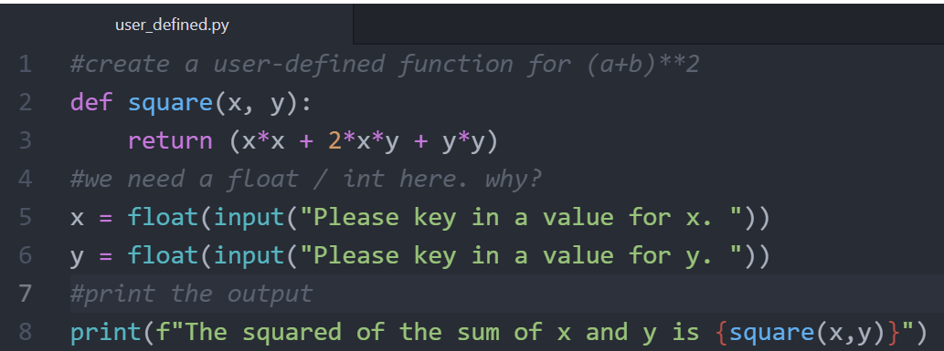
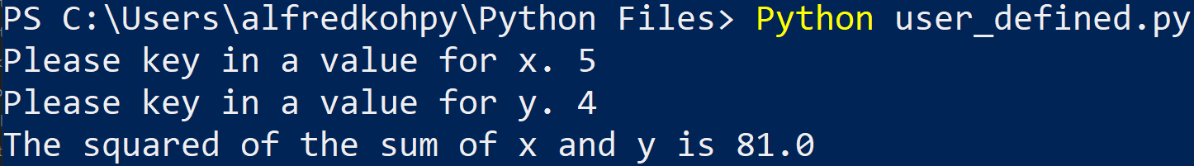
Example: user-defined functions

Slide 68
Activity
Boston housing data:
Use Jupyter lab.
Go to the ANL252_HousingData notebook file and run through the cells that apply a user function to summarise values found in array, tuples and lists for the housing dataset
There are also graphical plots you can apply to help you explore the data
Discuss your observations from the program outputs

Slide 69
Activity
Car sales program:
Modify the Car sales program in a way that the checking of the input validity of the selling price should be conducted in a user-defined function.

Slide 70
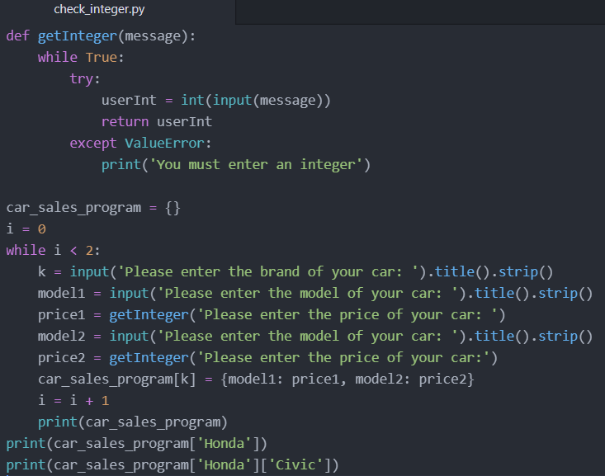
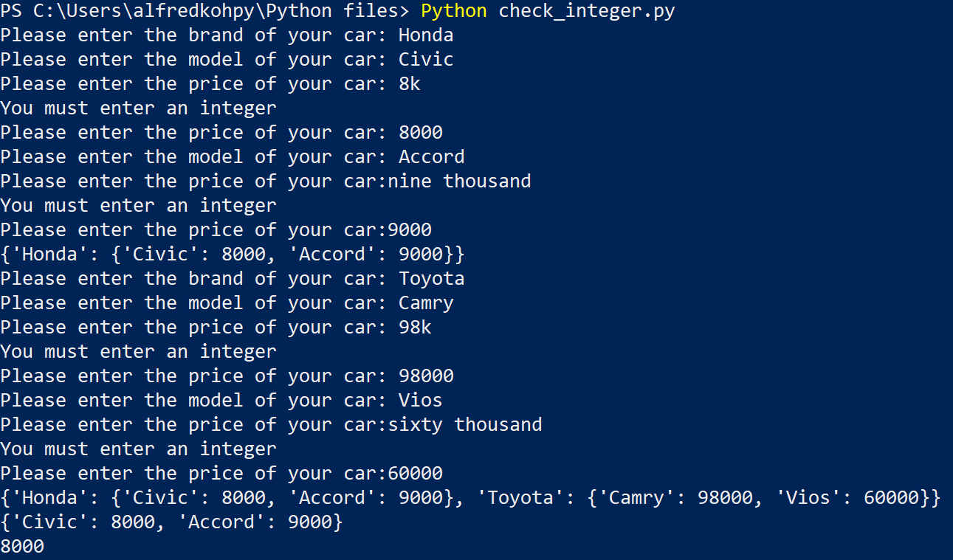
Activity (answers)

Slide 71
Discussion
When is it appropriate for us to write a user-defined function?

Slide 72
Discussion (answers)
When is it appropriate for us to write a user-defined function?
E.g., break very complex codes into chunks

Slide 73
Modules, Packages and Libraries (This section is for your information only because you are using Anaconda3)

Slide 74
Modules, Packages, Libraries
Python packages are like directories of Python scripts, or modules.
Modules specify functions, methods, and object types to solve certain tasks.
Packages may contain sub-packages or regular modules.
Packages of standard libraries are already installed in Python.
Library is a collection of codes to perform specific tasks without writing our own code.
Notes:
Beside build-in functions and methods, as well as user-defined functions, Python also provides packages which we can think of as a directory of Python scripts, the so-called modules. These modules specify new functions, methods, and object types for solving particular tasks. Packages are organised hierarchically, that means they may contain sub-packages, as well as regular modules themselves.
The packages of the standard library are installed along with the Python environment. A library is a collection of codes for us to perform specific tasks without writing our own code.

Slide 75
Import Packages and Modules
In Python, we can choose to import the entire package or a specific module of the package.
Use an alias to refer to a specific package or module from thereon in the program.
Alias is advantageous if the package or module has a very long name.
import package_name as package_alias
from package_name import module_name as module_alias
Notes:
But before we can use the modules in our program, we should first import the package or a specific module of the package.
In the first syntax, we import the whole package into our program. The alias is a name which we use to refer to that particular package from thereon in our program. It is advantageous to use a package alias if it has a very long name. Note that the “as alias” part is optional in the import syntax. If the original package name is preferred, this part can be omitted.
The second syntax imports a particular module from a package. The alias here is the referral name of the module that we will use in our program, and not the package. Once again, the alias part is optional and can be omitted.

Slide 76
Call Modules
If the whole package is imported, refer the package or its alias as prefix and call the module after a dot (.).
If only a single module is imported, call it directly by its name without referring to the package.
If only a single module is imported with an alias, use the alias instead of the original module name.
y = package_name.module_name(argument1, argument2, …)
y = package_alias.module_alias(argument1, argument2, …)
y = module_name(argument1, argument2, …
y = module_alias(argument1, argument2, …)
Notes:
If the whole package is imported and we want to call a certain module from it, we will need to use the package name as the prefix and then indicate the module after a dot.
If we have used an alias for the package name in the import process, we will have to use the second syntax instead of the first one.
But if we have only imported a single module from a package, we could call it directly by its name without referring to the package.
If we have only imported a single module from a package with an alias, we will have to use the alias instead of the original module name.

Slide 77
Install Packages with pip/pip3
More Python packages are available on the internet.
Download and install them by the pip or pip3 Python package.
Use PowerShell or Command Prompt as well (or similar terminal apps from other operation systems) to execute the following command:
“pip3” is a newer version of “pip”. Use either one for the installation.
> pip install package_name
> pip3 install package_name
Notes:
There are many Python packages available on the internet but not installed along with the Python environment.
To use those Python packages, we will first have to install them on our system. Then we can import them into our program same as the standard library. The simplest way to install such packages is to use PowerShell or Command Prompt as well (or similar terminal apps from other operating systems). Once we are prompted in the terminal window to give instructions to the operating system to carry out, type in one of the commands here and then press return:
“pip” or “pip3” refer to the installer program that Python uses for installing external packages. Basically, “pip3” is a newer version of “pip”. In most of the cases, we can use either one for our installation.

Slide 78
Upgrade and Uninstall Packages
To update/upgrade a package, we need to type the following syntax in the terminal apps.
Uninstall a package by the command:
> pip install package_name --upgrade
> pip3 install package_name --upgrade
> pip uninstall package_name
> pip3 uninstall package_name
Notes:
We can also update/upgrade a package with pip or pip3 by attaching the --upgrade option.
And we can also uninstall a package by replacing install with uninstall in the pip command.

Slide 79
Common Packages in Python
Here are some common packages for data analytics in Python.
Package | Description
matplotlib | Creates data visualisation
NumPy | Manages multi-dimensional arrays
pandas | Handles two-dimensional data tables
pendulum | Provides complex coding for dates and times
requests | Sends HTTP requests from Python code
scikit-learn | Provides tools of data analytics
scipy | Carries out scientific and technical computations
sqlite3 | Manages SQL database in Python
Notes:
In Python, there are some packages that are used quite commonly for data analytics. Here is a list of some common packages.

Slide 80
Activity
Install the following Python packages using pip or pip3:
NumPy
matplotlib
scikit-learn
sqlite3
JupyterLab

Slide 81
Discussion
When is it more sensible to import the entire package and when does it make more sense to import a single module?
Under which circumstances do we need an alias for a package or module? Are there any rules for an alias like a variable name?

